Slide 1
Capstone project
Raymond Normeshie
Data science

Slide 2
Project title
BUDGET ACCOMMODATION IN GHANA

Slide 3
PROJECT OUTLINE
Introduction
Project Description
Data Exploration
Data Quality Assessment
Insights
Analysis & Visualization
Project Goal
Dataset Description
Data Cleaning & Preprocessing
Conclusion & Recommendation

Slide 4
INTRODUCTION
PROJECT DESCRIPTION
This project is about accommodation system in Ghana. A key objective of this project is to provide opportunities to find out how safe and affordable the accommodation situation is in Ghana. The housing situation is believed to be far from the UN Sustainable Development Goal (SDG Goal 11). As a result, it would be very important to investigate the housing situation in Ghana and provide an understanding of the housing situation. This insights from this project can be useful in making certain decision for people seeking accommodation in Ghana by providing a description of places in the country that provides the best options for budget accommodation.

Slide 5
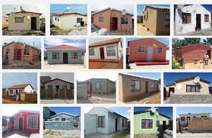
DRIVING QUESTION (PROJECT GOAL)
WHERE IN GHANA CAN YOU FIND THE BEST OPTIONS FOR BUDGET ACCOMMODTION?

Slide 6
DATASET DESCRIPTION
The dataset used in this project was scraped from an e-commerce website called Meqasa that provide listings for various kinds of accommodation across the country.
Greater-Accra being the capital of Ghana, it offers a lot of prospects for accommodation or houses for rent. Thus, majority of houses available for rent in Ghana are found in Greater Accra with a very few others found in other regions.
The Dataset obtained and used for this project have about 2073 entries and 14 features.

Slide 7
Data exploration
DATA QUALITY ASSESSMENT
The dataset was explored with the aid of determining missing values, accuracy of field values and presence of duplicates. There were missing values for which some were resolved by complete removal and filling-in, and duplicates were also removed.
DATA CLEANING AND PREPROCESSING
Some features or columns scraped which were not going to be needed for analysis were removed. The remaining columns were cleaned and transformed to their appropriate datatype before being used for analysis.

Slide 8
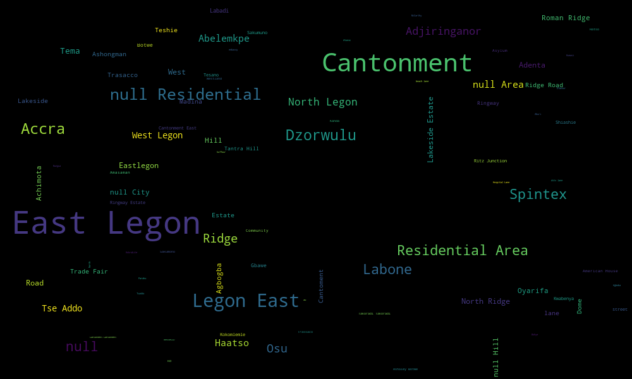
INSIGHTS FROM ANALYSIS
Location with Most available Houses for Rent.
From the Word cloud, we see that two (2) locations seem to be most frequently seen available for accommodation. They are Cantonment and East Legon.

Slide 9
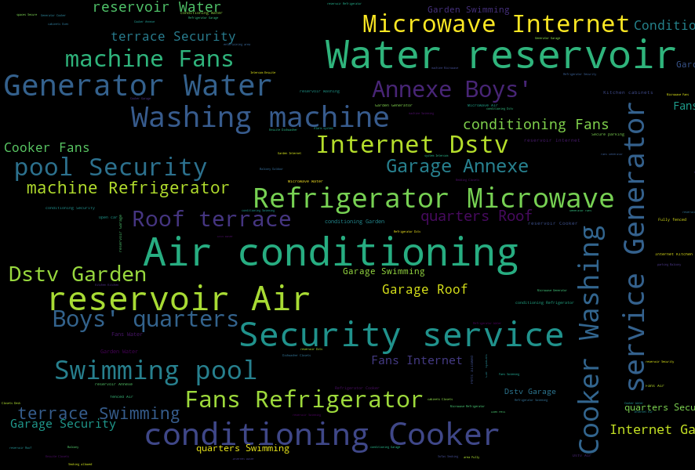
Cont’d
Most Common amenities found in Houses:
The most important or common amenities found in the houses available include the Air Conditioning and water Reservoir.

Slide 10
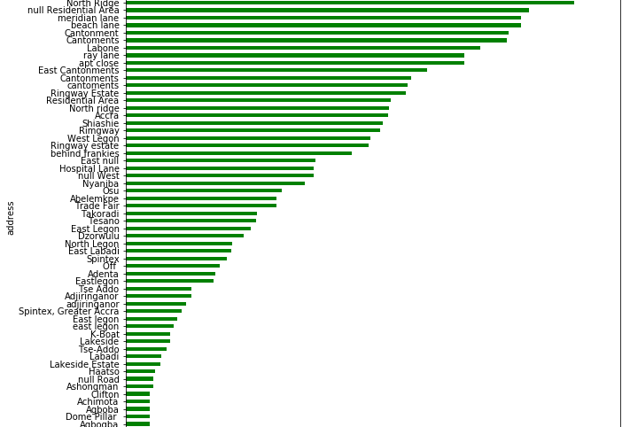
Cont’d
Where to find a budget Accommodation:
The bar graph indicates or shows where to locate budget accommodation in Ghana. It can be seen that to find very cheap accommodation in Ghana, one need to go to places like Agbogba, Dome and Achimota. However, this would depend on the number of bedrooms that one seeks to rent

Slide 11
CONCLUSION
Through the analysis, one insight drawn was the places that one can find cheap and affordable houses to rent in Ghana. Most houses are however centered in Accra and that make it the best place to find budget accommodation in Ghana.
Also, some notable amenities that one is likely to find in the rented houses are water reservoir and air conditioning.
Even though East Legon and Cantonment seem to have the most available accommodations, they are relatively expensive as compared to others.

Slide 12


